Slide 1
Job Performance Strategy Model
Hayley Baek
Notes:
My name is Hayley and this is my presentation for this company’s current job performance strategy. I’m going to go over how this company can improve its revenues by suggesting a few different strategies to create an optimized model.

Slide 2
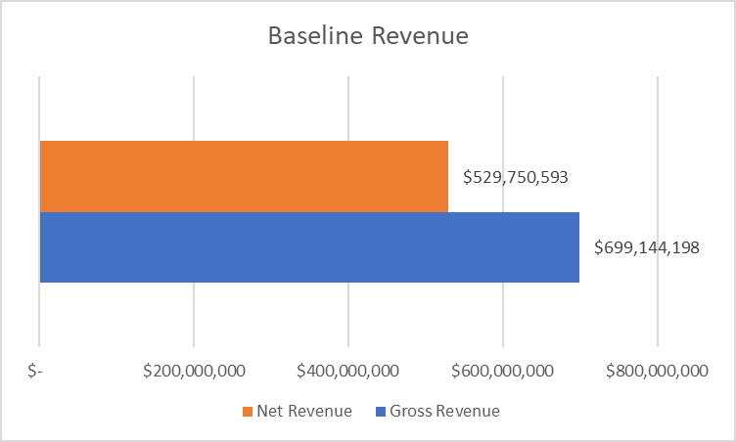
Baseline
These are our current numbers for net revenue and gross revenue
Goal: Optimize workforce planning to be in line with the $1B revenue goal of the company
Net revenue = $529M ; Gross revenue = $699M
Notes:
[x] This is our baseline for net revenue and gross revenue.
[x] The goal of this model is to optimize workforce planning to be in line with the company’s $1b revenue goal.
[x] Net revenue is currently around $530m, and gross revenue is currently around $700m.

Slide 3
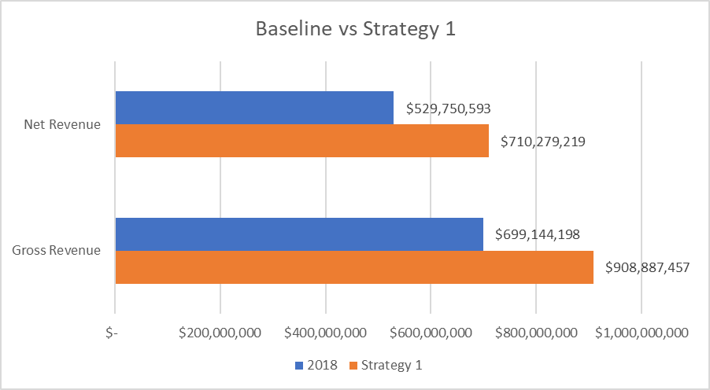
Strategy 1
Assume consistent compensation structure and no growth in headcount
Optimize by assuming company grows its book of business
Net revenue = $710M (+34%) ; Gross revenue = $908M (+30%)
Notes:
For the first strategy, [x] there is an assumption of consistent compensation structure and no growth in headcount.
[x] Revenue is optimized by assuming that the company grows its book of business.
[x] This strategy projects that there will be a 34% increase in net revenue to $710m and a 30% increase in gross revenue to $908m.

Slide 4
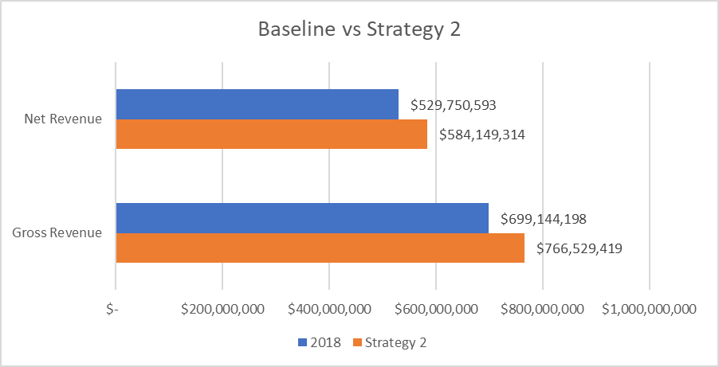
Strategy 2
Modify the pay structure to boost incentives for employees and to maximize net revenue
Net revenue = $584M (+10%) ; Gross revenue = $766M (+10%)
Notes:
The second strategy suggests that [x] the pay structure is modified to boost incentives and to maximize the net revenue.
[x] This is expected to have a 10% increase in net revenue to about $585m and a 10% increase in gross revenue to $744m.

Slide 5
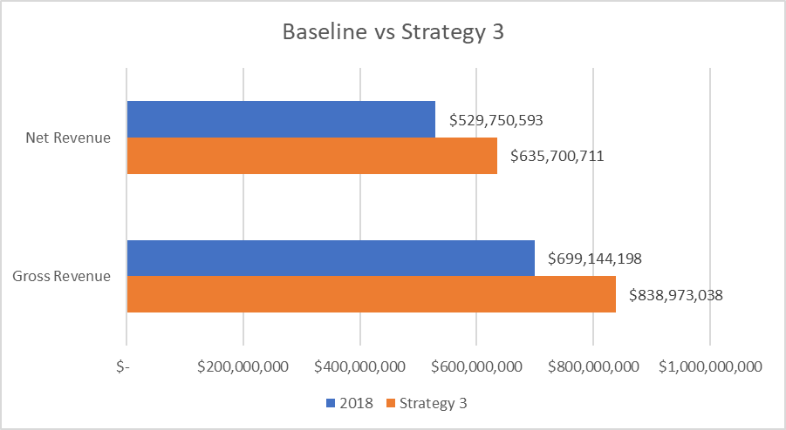
Strategy 3
Increase the headcount
Net revenue = $635M (+20%) ; Gross revenue = $838M (+20%)
Notes:
The third strategy is to [x] increase the headcount.
[x] Increasing the headcount will increase net revenue by 20% to $635m and the gross revenue by +20% to $838m.

Slide 6
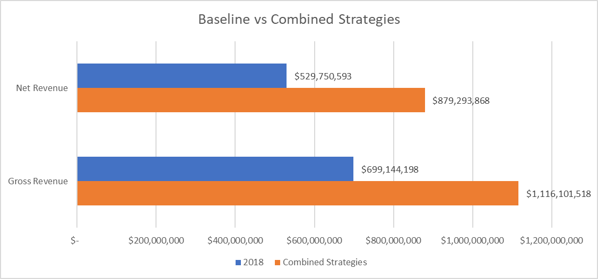
Combined strategies
Modifying quotas, growth, headcount, and commission structure to optimize forecasted revenue for 2019
Net revenue = $879M (+66%) ; Gross revenue = $1B (+60%)
Notes:
This strategy suggests combining these strategies [x] to modify quotas, growth, headcount, and commission structure to optimize these forecasted revenues for 2019.
With all of these strategies together, [x] the net revenue is projected to increase 66% to almost $880m and gross revenue by 60% to $1b.

Slide 7
Conclusion
Strategy 1
Net revenue = $710M (+34%) ; Gross revenue = $908M (+30%)
Strategy 2
Net revenue = $584M (+10%) ; Gross revenue = $766M (+10%)
Strategy 3
Net revenue = $635M (+20%) ; Gross revenue = $838M (+20%)
Combined strategies
Net revenue = $879M (+66%) ; Gross revenue = $1B (+60%)
Notes:
To conclude, [x] these are the different suggested strategies [x] and their projected impacts [x] on net revenue and gross revenue. [x] Strategy 1 is the best individual strategy, but combining all of these strategies is expected to yield the best overall result.

Slide 8
Conclusion
Strategy 1
Net revenue = $710M (+34%) ; Gross revenue = $908M (+30%)
Strategy 2
Net revenue = $584M (+10%) ; Gross revenue = $766M (+10%)
Strategy 3
Net revenue = $635M (+20%) ; Gross revenue = $838M (+20%)
Combined strategies
Net revenue = $879M (+66%) ; Gross revenue = $1B (+60%)
Combining strategies will meet the $1B revenue goal
Notes:
Since combining these strategies will help meet the $1b revenue goal, my recommendation is that the company modify its quotas, growth, headcount, and commission structure.

